Slide 1



UNIT 8;
Time to travel
My progress

Slide 2





What was your favourite lesson this year?
What do you remember the most?
Can you name some words you learned this year?
confidence
gadget
ability
6th grade

Slide 3
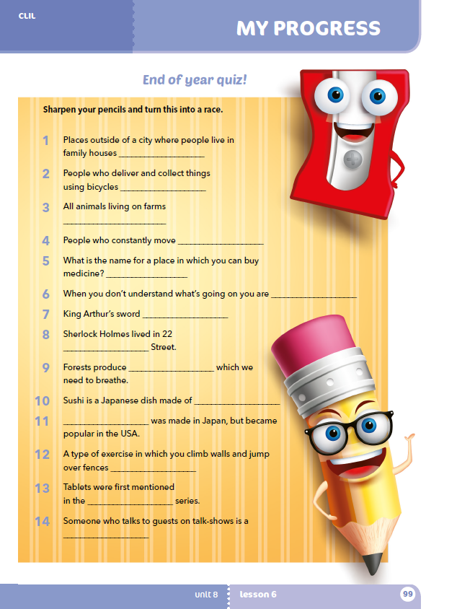
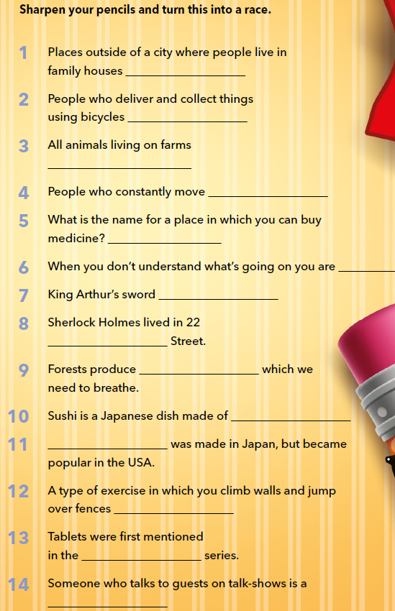
Workbook, p. 99.
Find the words.
Let’s practise:
https://wordwall.net/play/16954/099/917

Slide 4
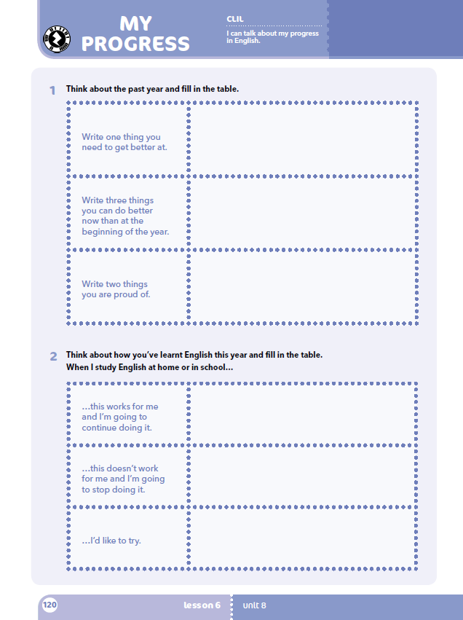
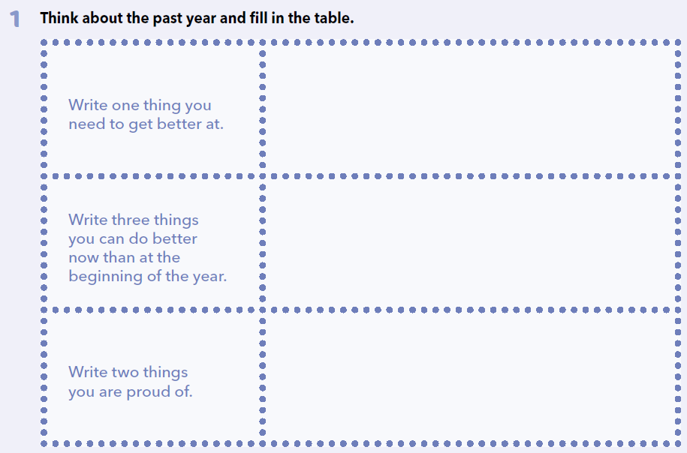
Zapiši jednu stvar u kojoj se moraš poboljšati.
Zapiši tri stvari u kojima si bolji sada nego na početku nastavne godine.
Zapiši dvije stvari na koje si ponosan.

Slide 5

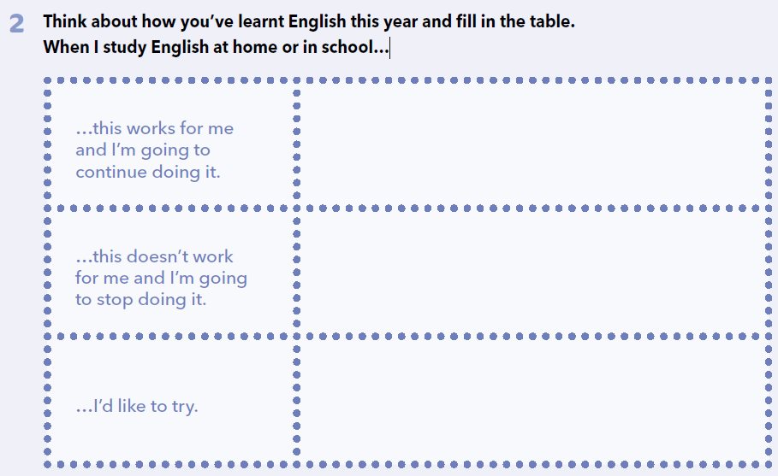
Zapiši načine koji ti pomažu da bolje naučiš i nastavit ćeš tako raditi i dalje.
Zapiši koji načini učenja tebi ne odgovaraju i prestat ćeš ih koristiti.
Zapiši što bi želio pokušati!
Learn more:
https://learningapps.org/watch?v=ppqjykj2j20

Slide 6
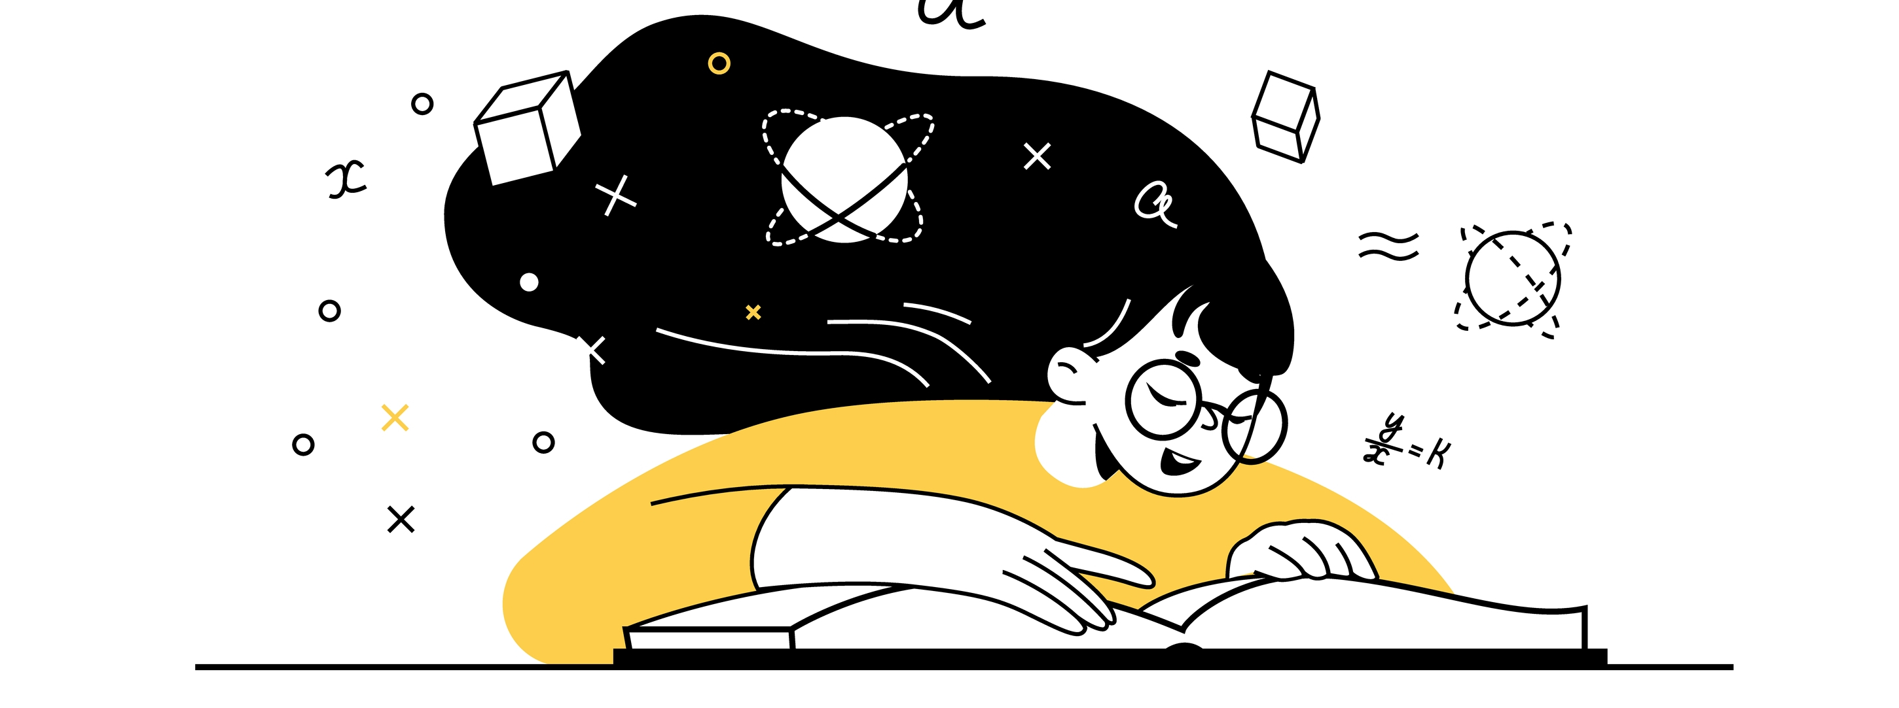
Choose one lesson from your book.
Why did you choose this lesson?
What was the most interesting thing about the lesson?
What was the most difficult thing to learn in this lesson?
Was there a funny situation you had learning it?
Use the link to make a meme :
https://imgflip.com/memetemplates?fbclid=IwAR1ueiofF8HHre7UkVHdkY6D-roVzfnO5T4OrqOculdo9Zf113nxxxC9gbM

